Slide 1
FOUNDATION OF METHEMATICS
TMS 1113
ALGEBRA CALCULATIONS & ALGEBRA EQUATION

Slide 2
Objectives
Practice the algebra calculations
Solving Algebraic equations
Cross-multiplication
Objectives

Slide 3

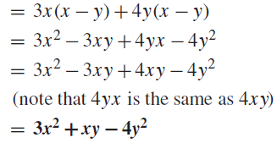
More exercises with Brackets
Evaluate followings :

Slide 4
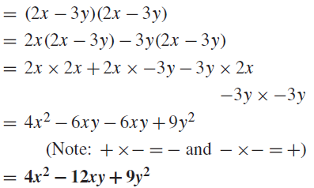
More exercises with Brackets
Evaluate followings :

Slide 5

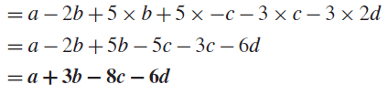
More exercises with Brackets
Evaluate followings :

Slide 6

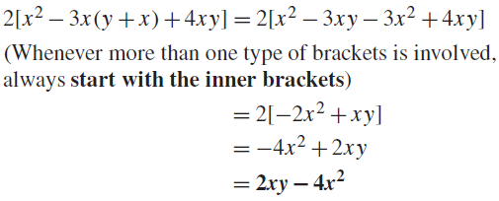
More exercises with Brackets
Evaluate followings :

Slide 7
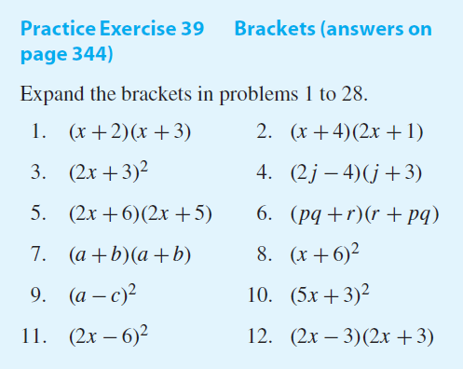

Slide 8
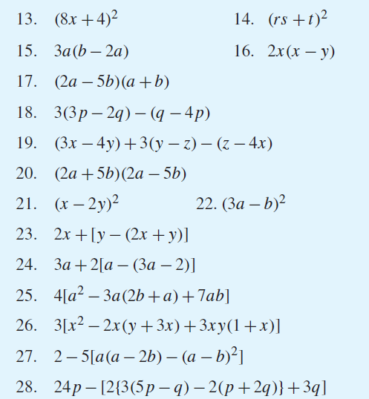
Now try the following Practice Exercise

Slide 9
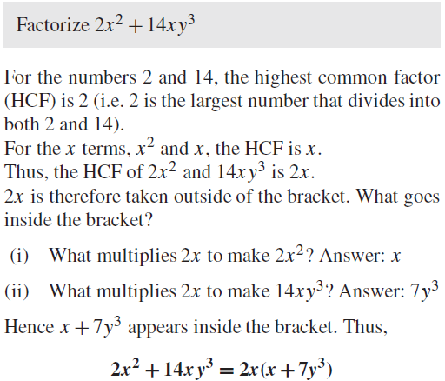
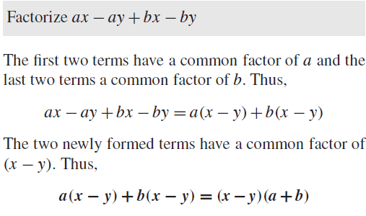
More exercises with Factorization
Evaluate followings :

Slide 10
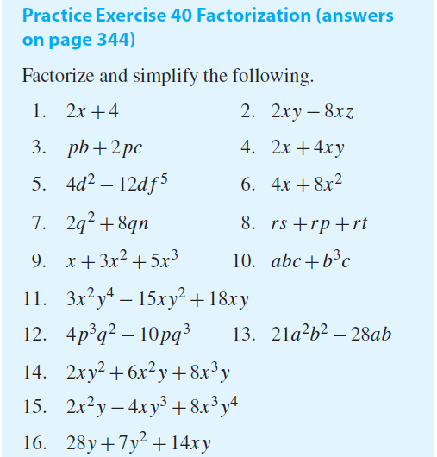
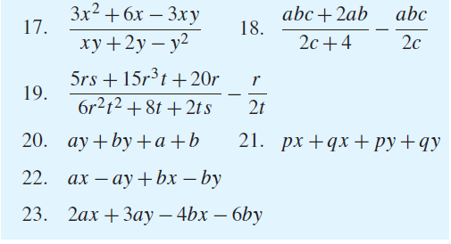
Now try the following Practice Exercise

Slide 11
Factorization
The factors of 8 are 1, 2, 4 and 8 because 8 divides by 1, 2, 4 and 8.
The factors of 24are 1,2,3,4,6, 8,12 and 24
The common factors of8and24are 1,2,4 and 8 since 1, 2, 4 and 8 are factors of both 8 and 24.
The highest common factor (HCF) is the largest number that divides into two or more terms. Hence, the HCF of 8 and 24 is 8

Slide 12

Factorization
a is common to both terms ab and −5ac.
a is therefore taken outside of the bracket.
What goes inside the bracket

Slide 13

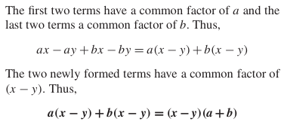

Slide 15
Now try the following Practice Exercise

Slide 16
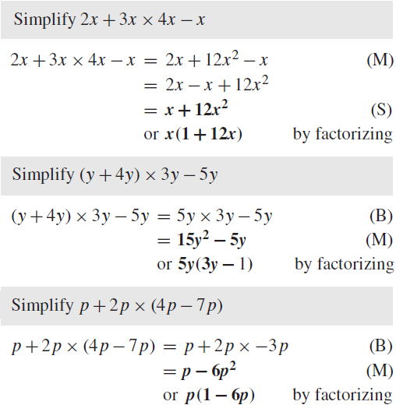
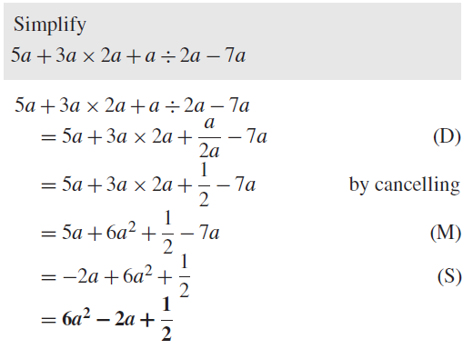
More exercises with Laws of precedence (BODMAS)
Evaluate followings :

Slide 17
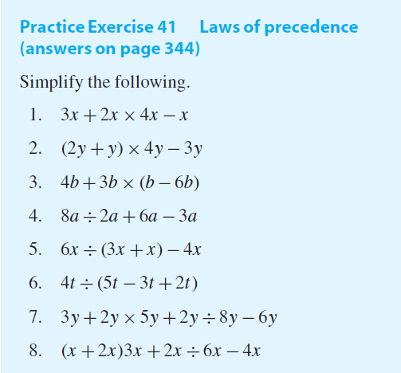
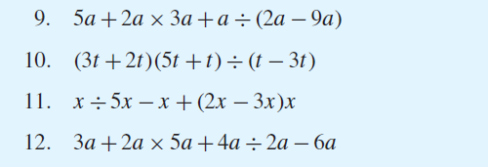
Now try the following Practice Exercise

Slide 18
An equation is a statement that 2 expressions are equal. The symbol “=“ is read “is equal to” and divides the equation into 2 parts, the left member and the right member. In the equation
2x + 3 = 13,
2x + 3 is the left member and 13 is the right member.
Algebraic Equations
The solution to an equation in one variable is the number that can be substituted in place of the variable and makes the equation true.
For example 5 is a solution to the equation 2x + 3 = 13 because 2(5) + 3 = 13 is true.
To solve an equation means to find all solutions or roots for the equation.

Slide 19
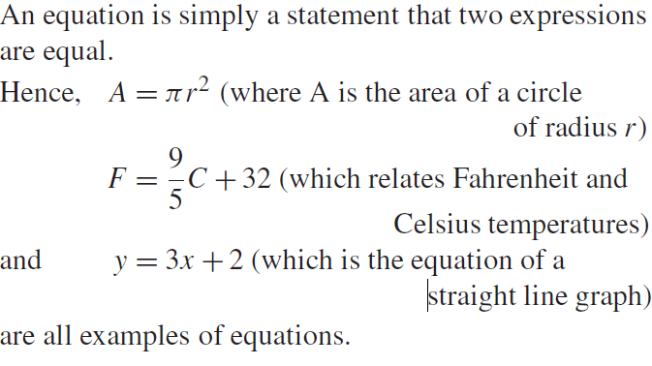
Examples

Slide 20
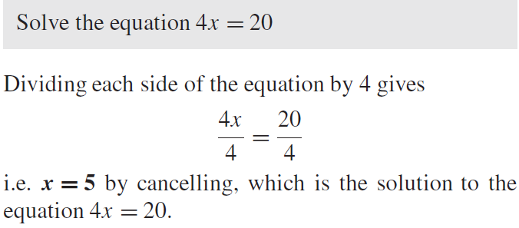
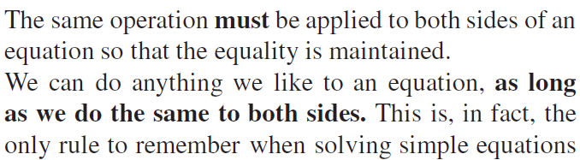
Solving equations
To ‘solve an equation’ means ‘to find the value of the unknown’.

Slide 21
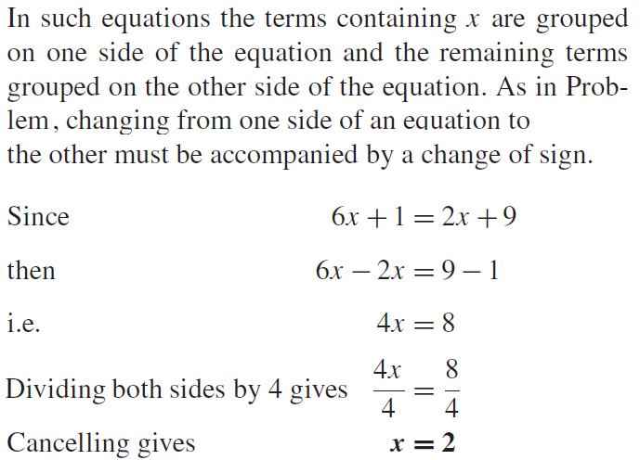
A term of an equation can be moved from one side to the other as long as a change in sign is made.

Slide 22

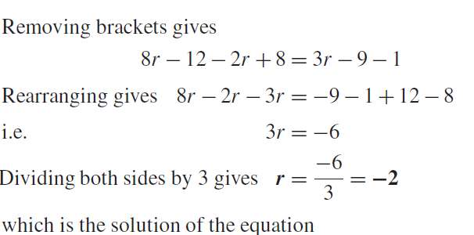
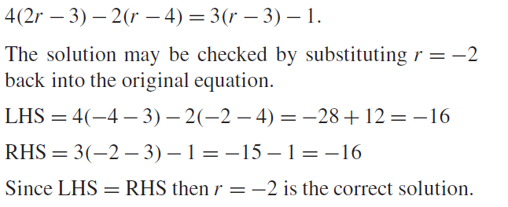

Slide 23
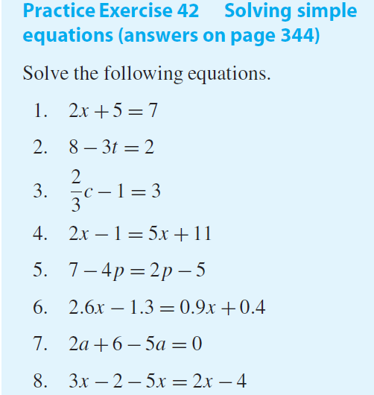
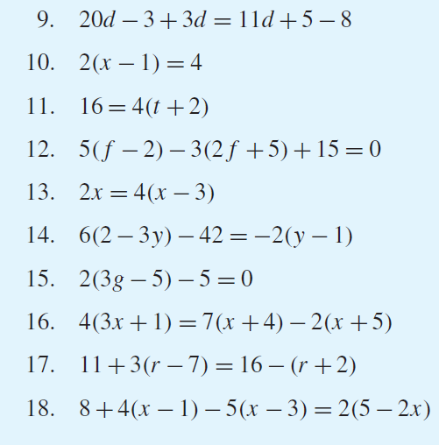

Slide 24

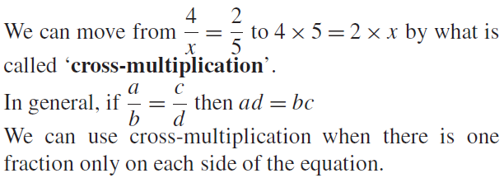
How to do cross-multiplication ?
When there is just one fraction on each side of the equation as in the following example, there is a quick way to arrive at equation, by dong cross multiplication.

Slide 25
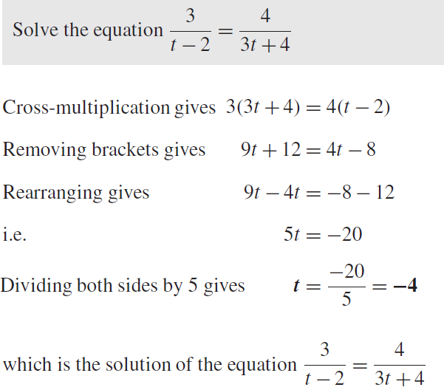

Slide 26
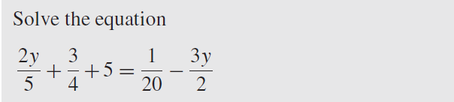
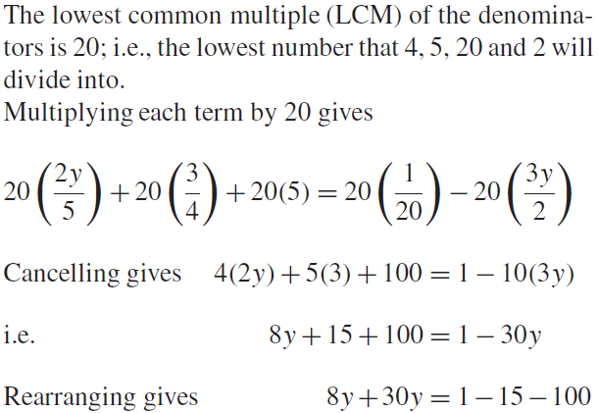
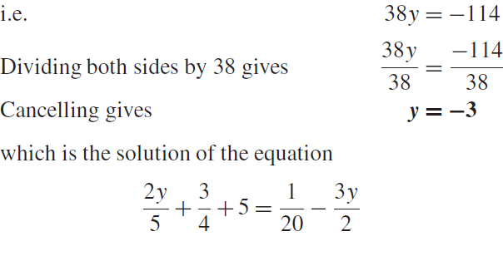

Slide 27
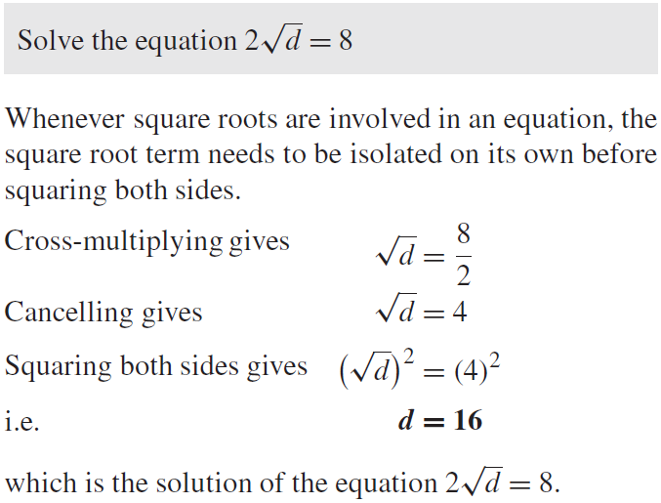

Slide 28
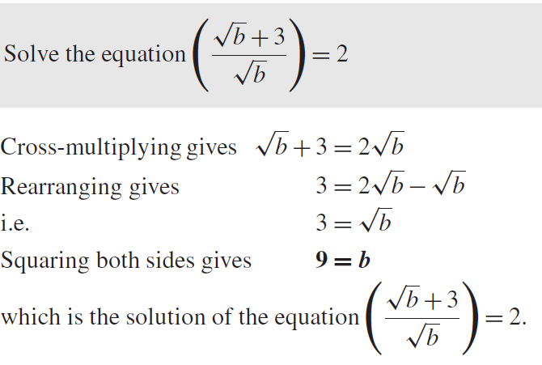

Slide 29
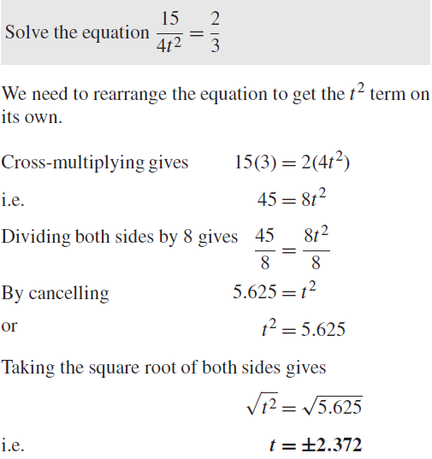

Slide 30
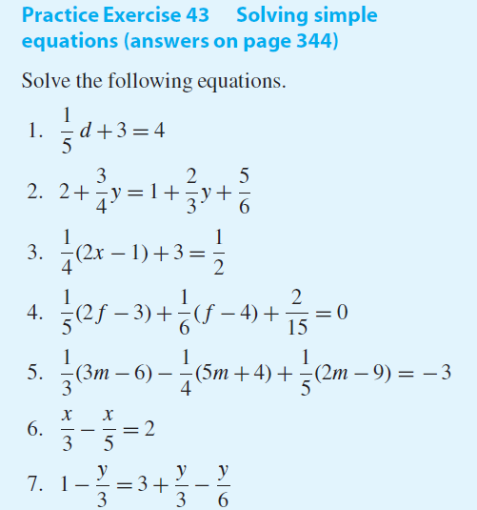
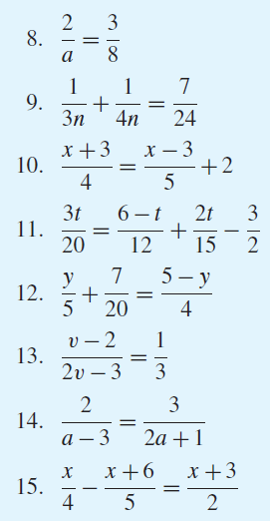
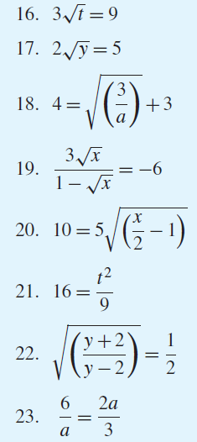

Slide 31
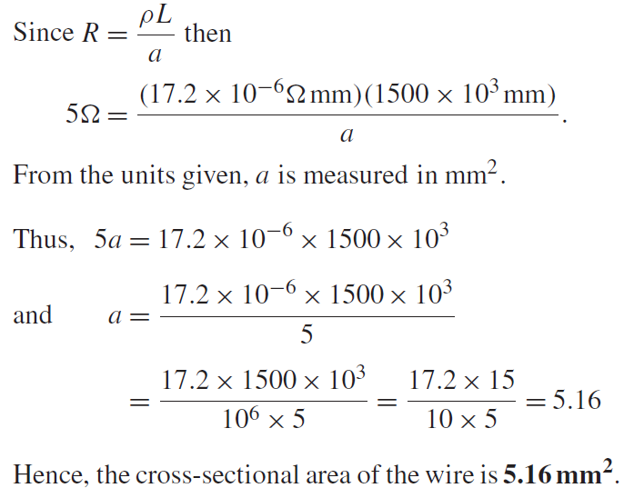
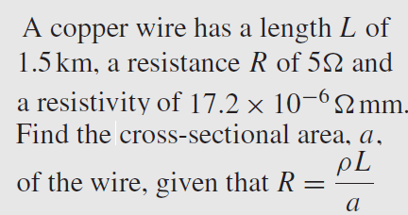
Practical problems involving simple equations

Slide 32
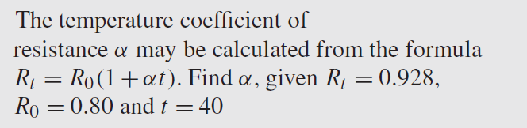
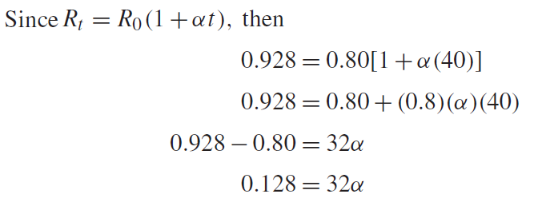

Slide 33
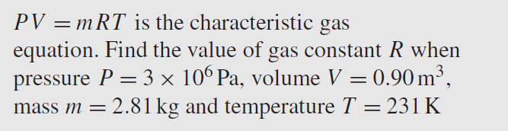


Slide 34
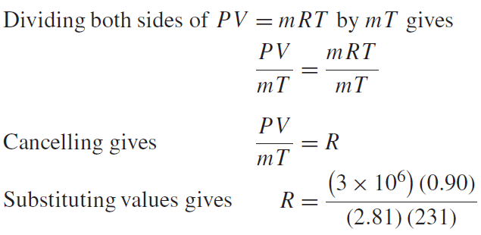

Slide 35
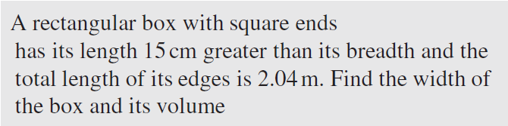
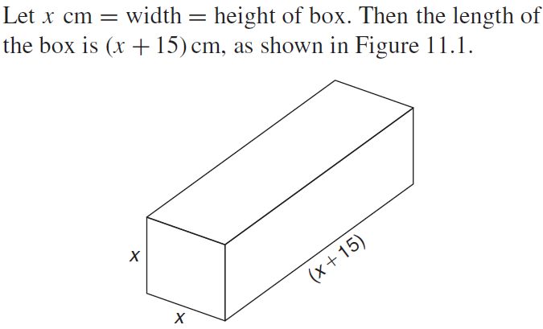

Slide 36
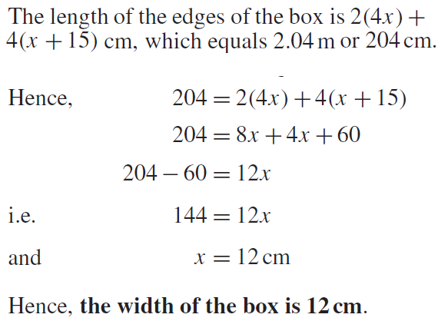

Slide 37
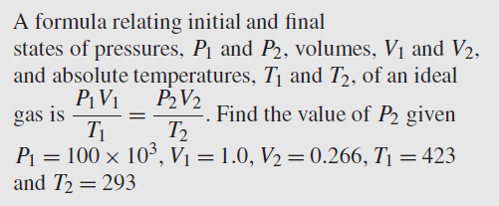

Slide 38
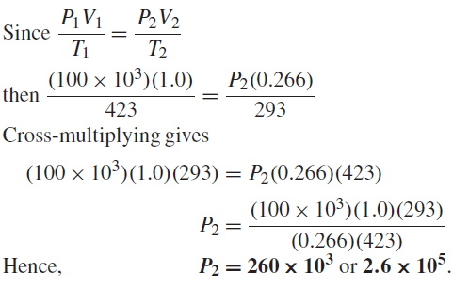

Slide 39
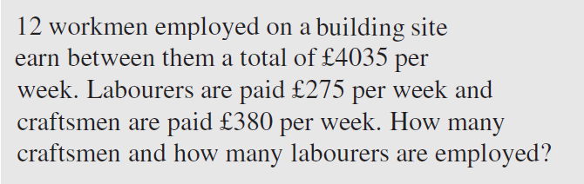

Slide 40
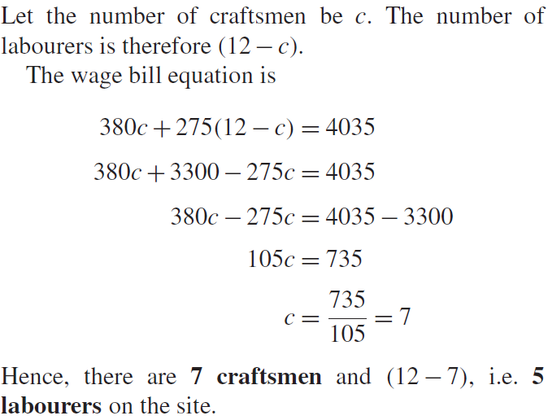

Slide 41
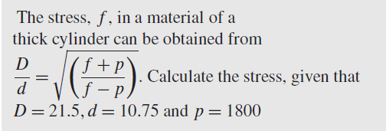
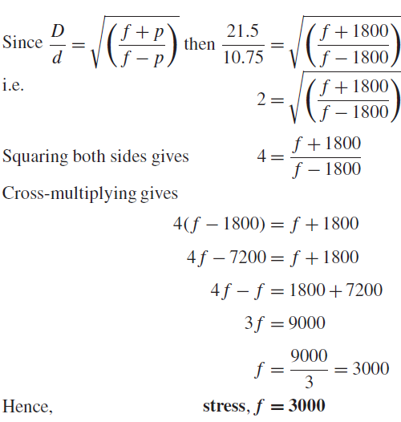

Slide 42
Homework
Practice Exercise 44 Practical problems involving simple equations (answers on page 344)
Practice Exercise 45 Practical problems involving simple equations (answers on page 344)
End of Lesson

